Slide 1

Nexthikes IT Solutions
Job Market Analysis
&
Recommendation System
Project-8
Mahak goyal

Slide 2
Agenda
Objective Define the purpose of analyzing job market data and building a recommendation system.
Situational Overview Highlight the current challenges and opportunities in the job market.
Project Tasks & Deliverables Break down the project into tasks: analysis, prediction, and recommendation engine.
Technology & Tools List data sources, ML libraries, visualization tools, and deployment technologies.
Incorporating Docker Explain how Docker ensures portability, consistency, and easy deployment.
Results & Insights Present key findings, dashboards, and recommendations generated by the model.

Slide 3
Objective
Primary Objective:
Analyze job market trends and build a recommendation system for job seekers.
Identify high-demand job roles, salary trends, and emerging job categories.
Provide personalized job recommendations using real-time data.
Outcome:
Empower job seekers and recruiters to make data-driven career decisions.

Slide 4
Situational Overview
Need for actionable insights:
Understand market changes
Identify opportunities faster
Adapt skillsets to meet demand
The job market is dynamic, influenced by:
Technological advancements
Economic shifts
Cultural trends
Approach:
Use data analytics + machine learning models to uncover trends
Provide data-driven job recommendations

Slide 5
Project Architecture & Methodology
Data Sources: Mention that the data will be accessed from specified sources.
Technology & Tools: List the core technologies:
Analytics: Python, Pandas, Scikit-Learn, TensorFlow.
Visualization: Matplotlib, Seaborn, Plotly.
Web: Flask or Django.
Containerization: Docker.
Methodology: Briefly describe the approach (Data Analysis -> Predictive Modeling -> Recommendation Engine).

Slide 6
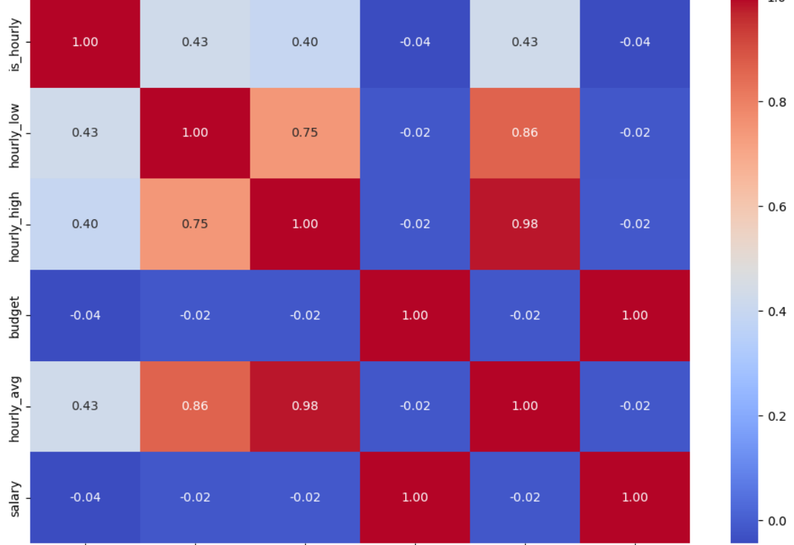
Task 1: Correlation Analysis
Objective: To analyze the relationship between job title keywords and offered salaries.
Process: Explain the steps taken, such as extracting keywords, normalizing salary data, and performing statistical analysis.
Deliverable: A report with statistical analysis and visualizations of the correlation.
Expected Insight: Show which skills or job titles are associated with higher salaries.

Slide 7
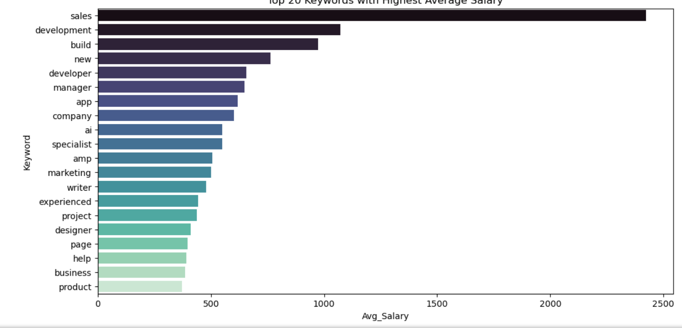
Top 20 Keywords
Analysis: Show the top 20 most frequent keywords from the job titles.
Visual: Display the output of the keyword frequency analysis. Highlight keywords like 'needed', 'website', 'developer', and 'expert'.
Insights: Discuss what these top keywords reveal about the most in-demand skills or roles on the platform.

Slide 8
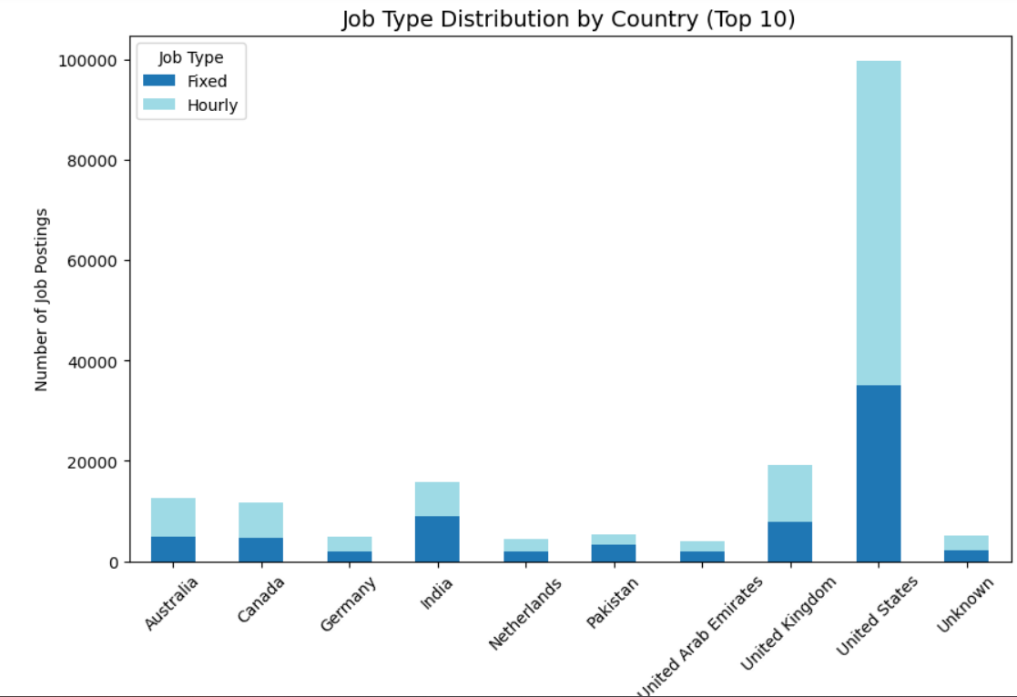
Top 20 Bigrams (Two-Word Phrases)
Analysis: Present the top 20 most frequent bigrams (two-word phrases).
Visual: Display the output of the bigram frequency analysis. Highlight popular phrases such as 'social media', 'video editor', and 'graphic designer'.
Insights: Explain how bigrams provide more context than single keywords, showing specific job roles and niches.

Slide 9
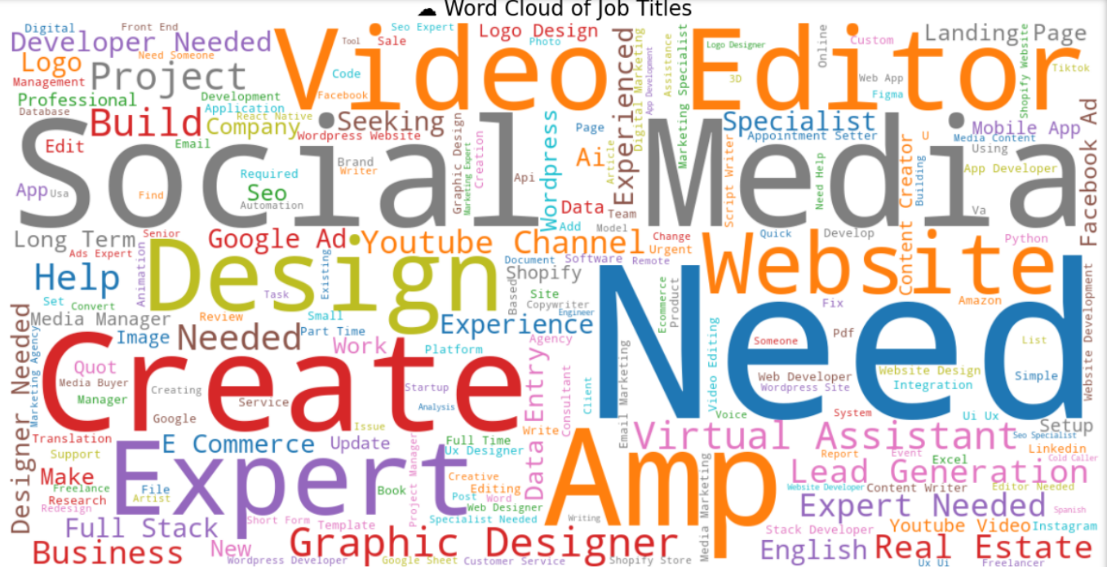
Word Cloud Visualization
Visual: Show a word cloud generated from the job titles .
Explanation: Describe what a word cloud is and how it visually represents the most frequent terms in the dataset.
Key Takeaway: Summarize the main themes and job types that are most prominent.

Slide 10
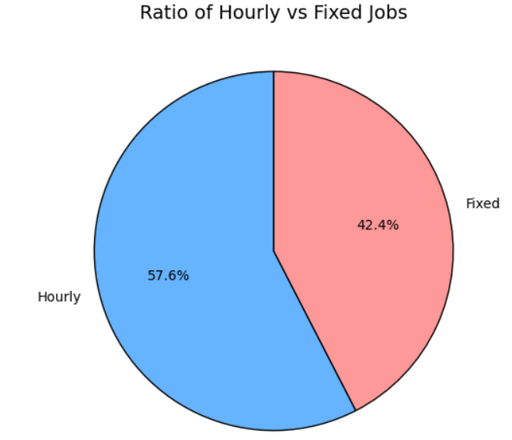

Job Type Distribution
Visualization: A pie chart or a bar chart is perfect for this. A pie chart shows the proportion of Hourly versus Fixed-Price jobs, while a bar chart can show the absolute counts of each.
Insight: This visualization clarifies which payment model is more common on Upwork, a critical piece of information for both freelancers and clients.

Slide 11
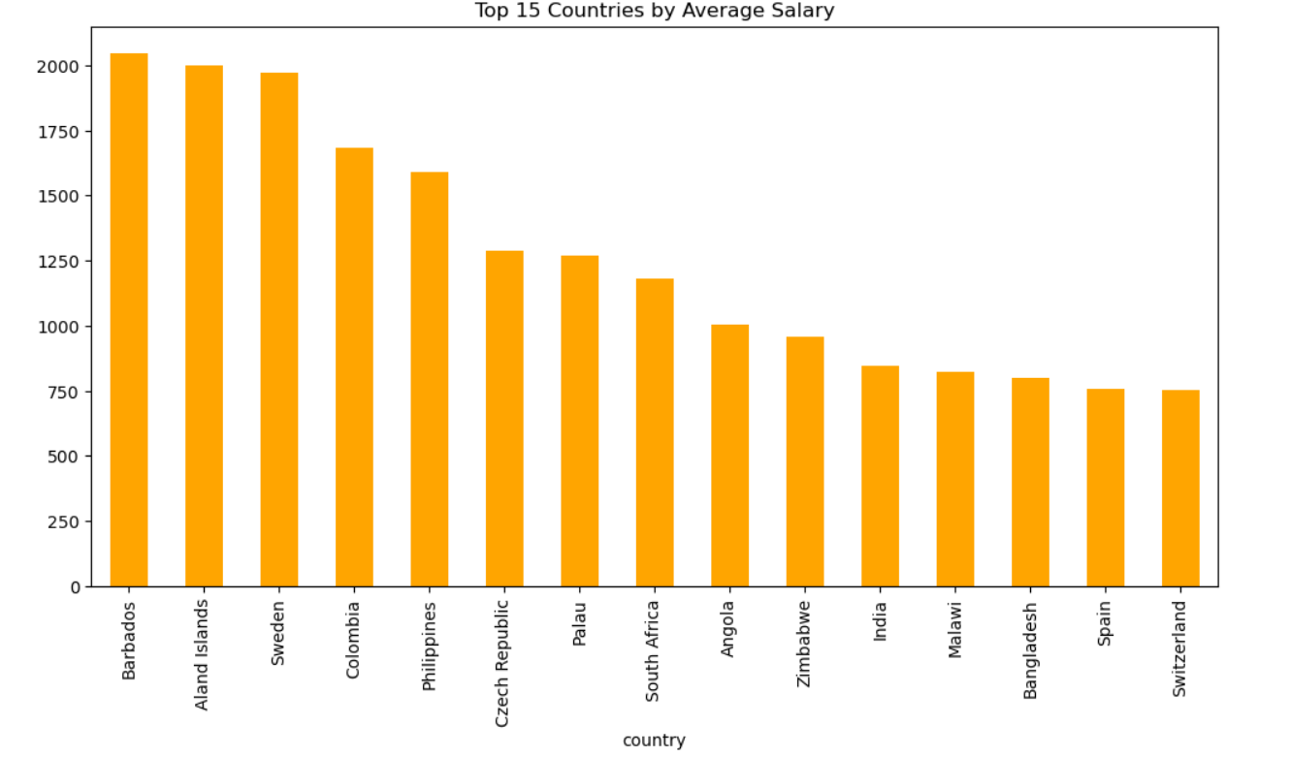
Top Keywords by Average Salary
Visualization: A horizontal bar chart is excellent for this purpose. The y-axis would list the keywords, and the x-axis would show the average salary. Sorting the bars from highest to lowest salary makes it easy to identify the most lucrative keywords.
Insight: This chart directly links skills to earning potential, revealing which specializations command the highest average pay.

Slide 12
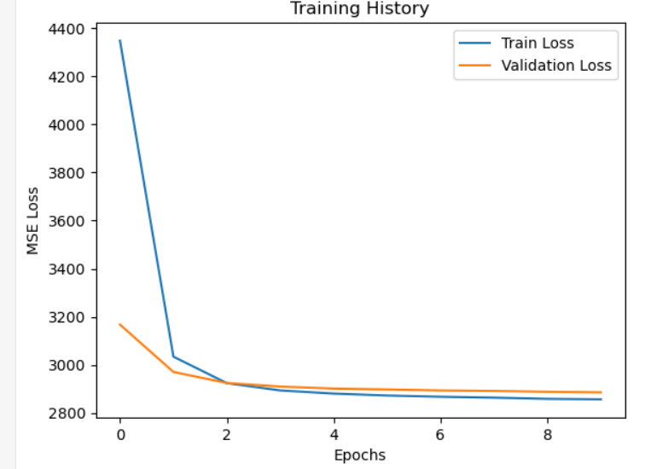
High-Demand Job Roles
Objective: Explain how the project uses job posting patterns over time to forecast high-demand job roles.
Process: Briefly describe the predictive model and the features it uses (e.g., TF-IDF vectors from titles, numeric data).
Result: Discuss the predictive model's ability to forecast future demand, with a mention of the accuracy metrics used (e.g., MAE).

Slide 13
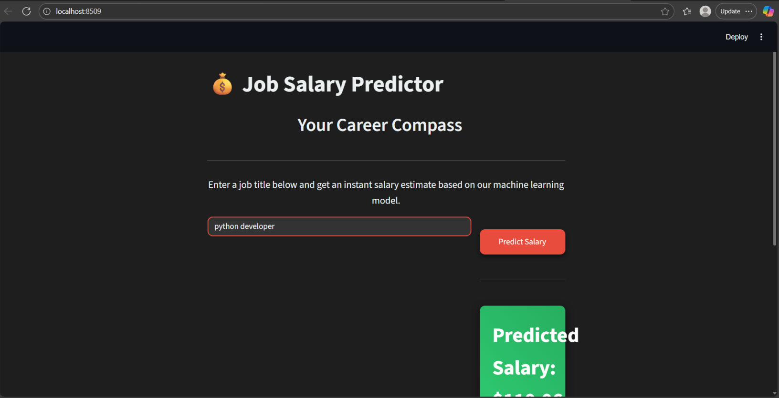
The Recommendation Engine & Deployment
Objective: To develop a personalized job recommendation engine based on the analysis.
Functionality: Explain how the engine would work (e.g., matching user profiles to job keywords and salary data).
Deployment: Briefly touch on the use of Docker and Streamlit to package and deploy the model for a user-friendly experience.

Slide 14
Conclusion & Key Findings
Summary: Briefly recap the most important findings from the analysis.
The top skills and niches on the platform.
The most profitable keywords.
The most prevalent job types and geographical locations.
Overall Project Takeaway: Summarize what the analysis reveals about the current state of the Upwork freelance market and the project's value.

Slide 15
References
Python: https://www.python.org/
Pandas: https://pandas.pydata.org/docs/
Scikit-Learn: https://scikit-learn.org/stable/
Kaggle: https://www.kaggle.com/
Hugging Face: https://huggingface.co/
Thank you

